Slide 1
STOCK MARKET ANALYSIS
GROUP 5

Slide 2
CONTENTS
INTRODUCTION
EDA
MODEL BUILDING
DEPLOYMENT
CONCLUSION

Slide 3
INTRODUCTION
Stock market analysis is a vital tool for investors seeking to make informed decisions in the dynamic world of finance. By evaluating various factors such as market trends, company performance, economic indicators, and investor sentiment, analysts can gauge the potential risks and rewards associated with different investment opportunities. Technical analysis involves studying past market data and charts to predict future price movements, while fundamental analysis delves into a company's financial health and growth prospects. Additionally, sentiment analysis considers the emotional and psychological factors driving market behavior. By combining these analytical approaches, investors can develop well-rounded strategies to navigate the complexities of the stock market and optimize their investment portfolios for long-term success.

Slide 4
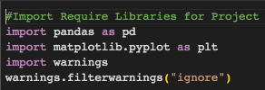

IMPORTING LIBRARIES
IMPORTING THE FILE

Slide 5

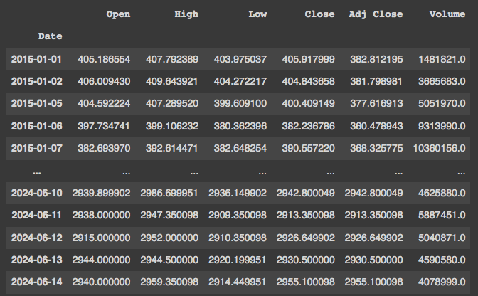
READING THE EXCEL FILE

Slide 6
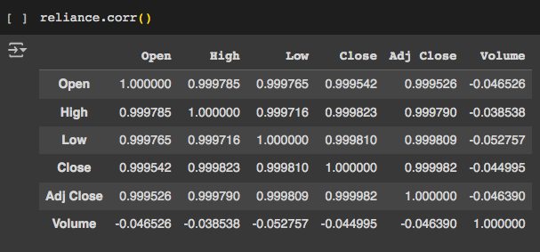
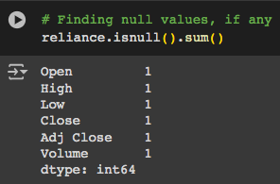
DATA PROCESSING
Effective data processing in stock market analysis involves collecting, cleaning, and transforming raw data to uncover patterns and trends. Techniques like data mining and machine learning help analysts make informed investment decisions. Accurate processing enhances understanding of market dynamics.

Slide 7
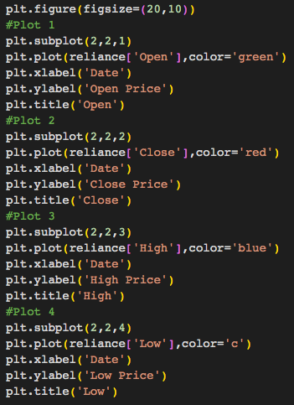
DATA PROCESSING

Slide 8
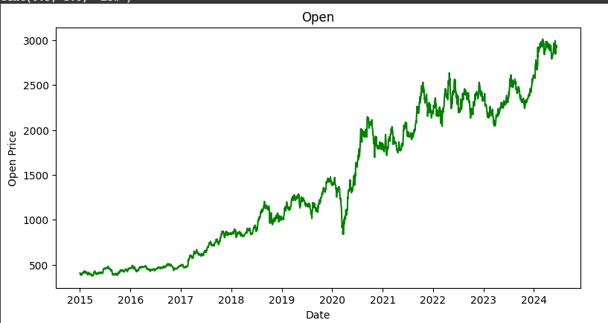
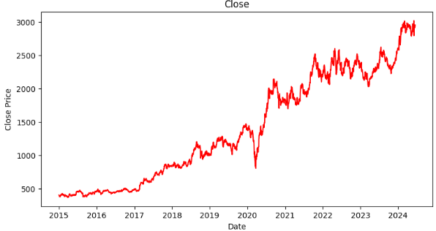
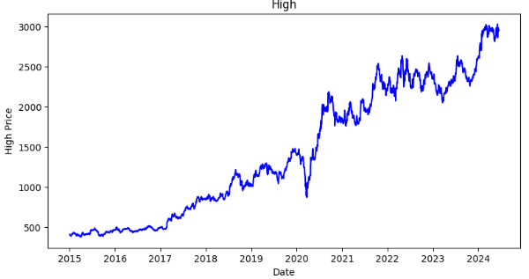
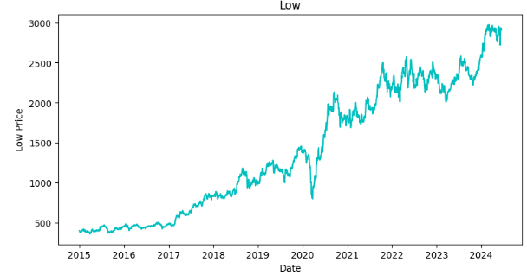

Slide 9

FEATURE ENGINEERING
Explanation of Simple Moving Average (SMA): Is one of the most commonly used technical indicators in stock analysis. It calculates the average of a selected range of prices, typically closing prices, by the number of periods in that range.
SMA is used by traders and analysts to:
Smooth out price data to identify trends over a specified period. Help reduce the "noise" from random short-term price fluctuations. Identify potential buy and sell signals:
When the short-term SMA crosses above a long-term SMA, it might signal a buy.
When the short-term SMA crosses below a long-term SMA, it might signal a sell.

Slide 10
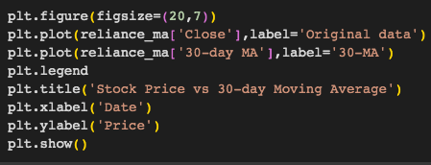
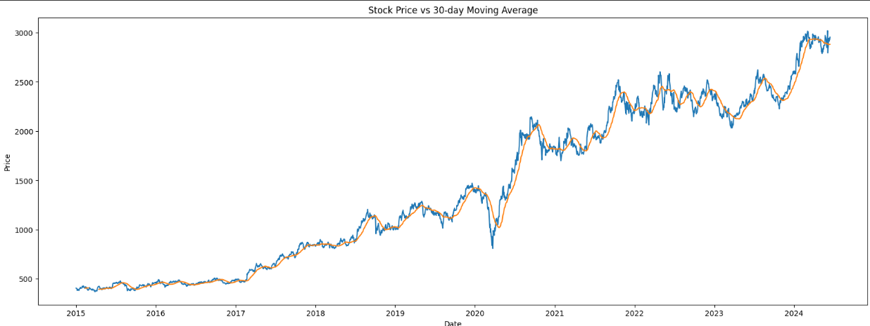
STOCK PRICE VS 30 DAYS AVERAGE

Slide 11
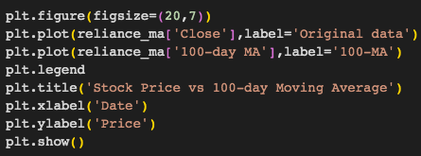
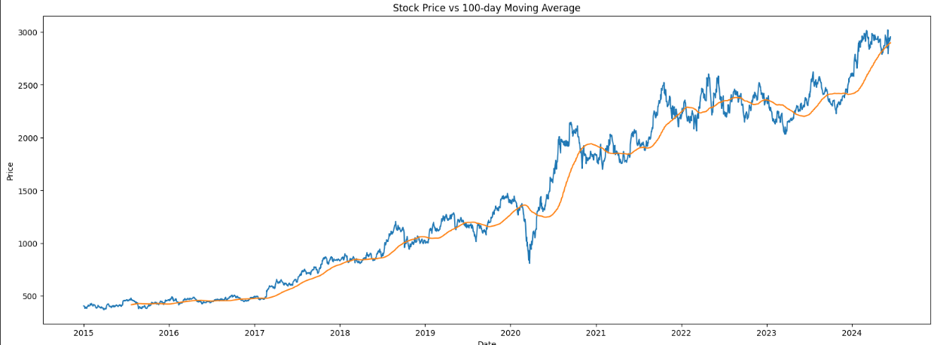
STOCK PRICE VS 100 DAYS AVERAGE

Slide 12
MODEL BUILDING
Model building is a crucial aspect of stock market analysis, involving the creation of mathematical and statistical models to predict market trends and stock prices. Analysts use techniques such as regression analysis, time series analysis, and machine learning to develop these models. By analyzing historical data and identifying patterns, these models can forecast future market movements, aiding in risk assessment and investment decision-making. Effective model building requires a deep understanding of market behavior, rigorous testing, and continuous refinement to improve accuracy and reliability.

Slide 13
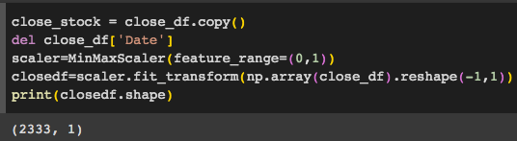
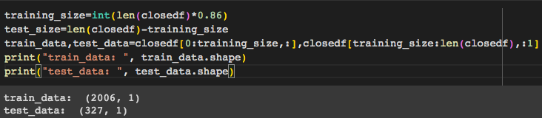
Normalizing / scaling close value between 0 to 1
Split data for training and testing

Slide 14
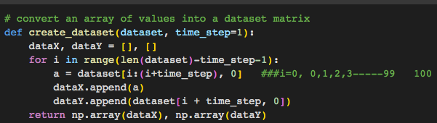
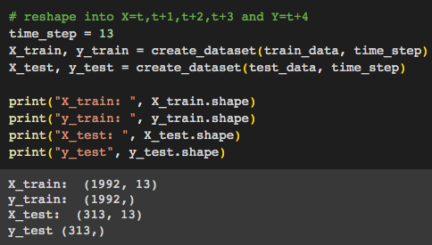
CREATING NEW DATA SET ACCORDING TO REQUIREMENT OF TIME SERIES PRODUCTION

Slide 15
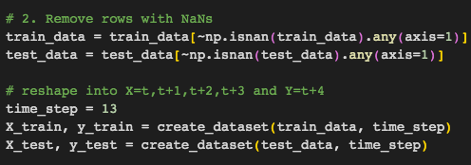
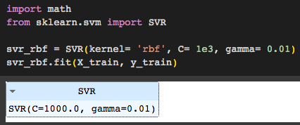
ALGORITHMS - SUPPORT VECTOR REGRESSION (SVR)
Support Vector Regression (SVR) is used in stock market analysis to predict future prices based on historical data. SVR handles non-linear relationships with kernel functions and is robust to outliers due to its epsilon-insensitive loss function. By selecting relevant features, tuning hyperparameters, and evaluating performance, SVR can provide accurate stock price predictions, aiding in investment decisions.

Slide 16
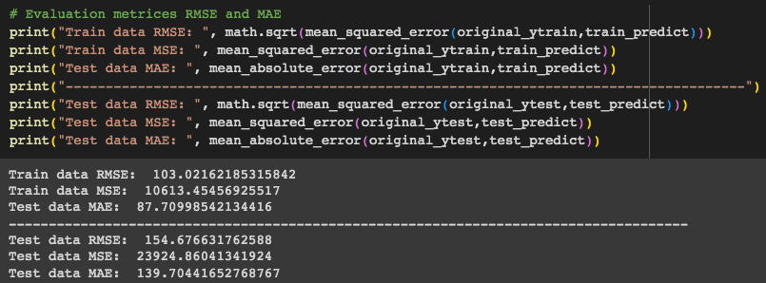
EVALUATION OF MATRICES RMSE, MSE AND MAE
Root Mean Square Error (RMSE), Mean Square Error (MSE) and Mean absolute Error (MAE) are a standard way to measure the error of a model in predicting quantitative data.

Slide 17
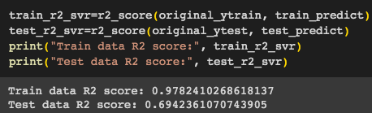
R2 SCORE FOR REGRESSION
R-squared (R2) is a statistical measure that represents the proportion of the variance for a dependent variable that's explained by an independent variable or variables in a regression model.
1 = Best
0 or < 0 = worse

Slide 18
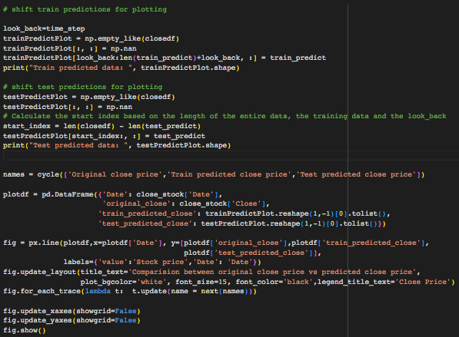
COMPARISON BETWEEN ORIGINAL STOCK VS PREDICTED CLOSE PRICE

Slide 19
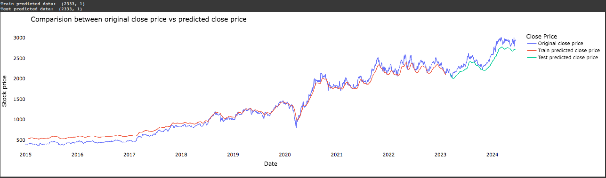
COMPARISON BETWEEN ORIGINAL STOCK VS PREDICTED CLOSE PRICE

Slide 20
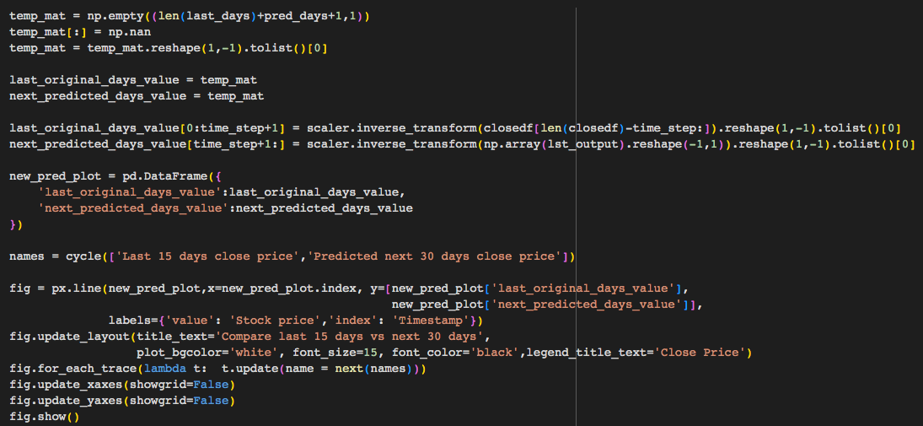
PLOTTING 15 DAYS AND NEXT PREDICTED 30 DAYS

Slide 21
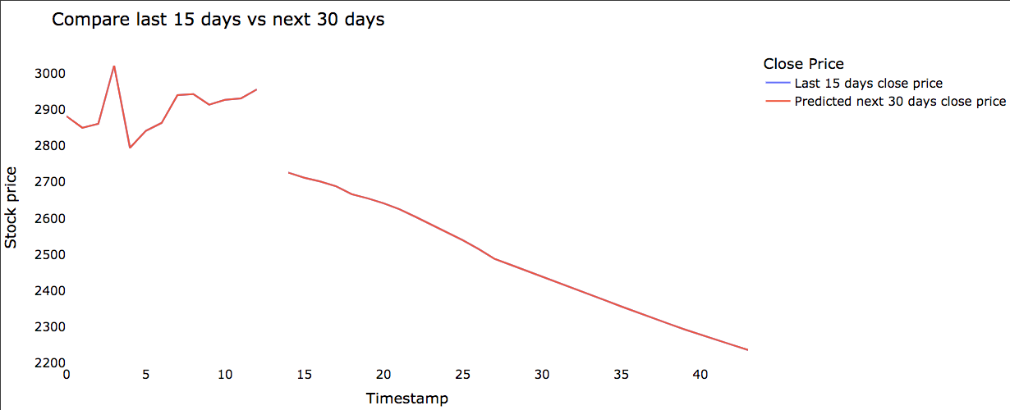
PLOTTING 15 DAYS AND NEXT PREDICTED 30 DAYS

Slide 22
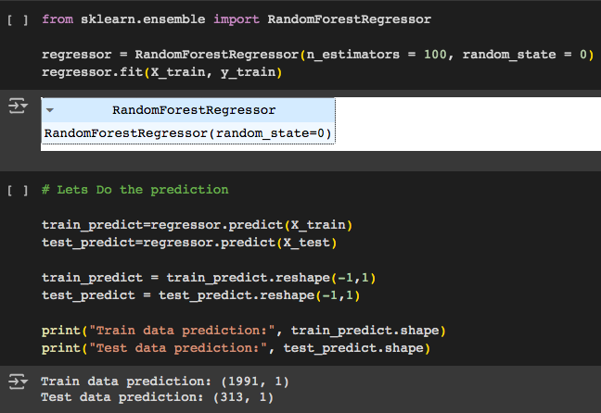
RANDOM FOREST REGRESSOR - RF

Slide 23
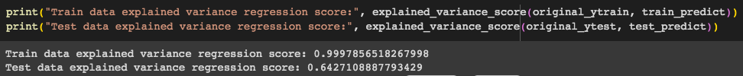
EXPLAINED VARIANCE REGRESSION SCORE
The explained variance score explains the dispersion of errors of a given dataset, and the formula is written as follows: Here, and Var(y) is the variance of prediction errors and actual values respectively. Scores close to 1.0 are highly desired, indicating better squares of standard deviations of errors.

Slide 24
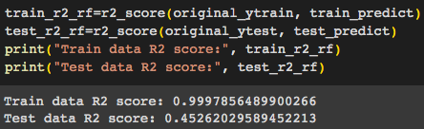
R2 SCORE FOR REGRESSION
R-squared (R2) is a statistical measure that represents the proportion of the variance for a dependent variable that's explained by an independent variable or variables in a regression model.

Slide 25
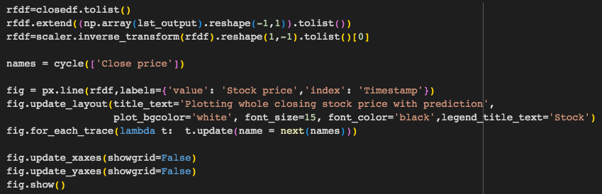
PLOTTING THE WHOLE CLOSING STOCK PRICE WITH PREDICTION

Slide 26
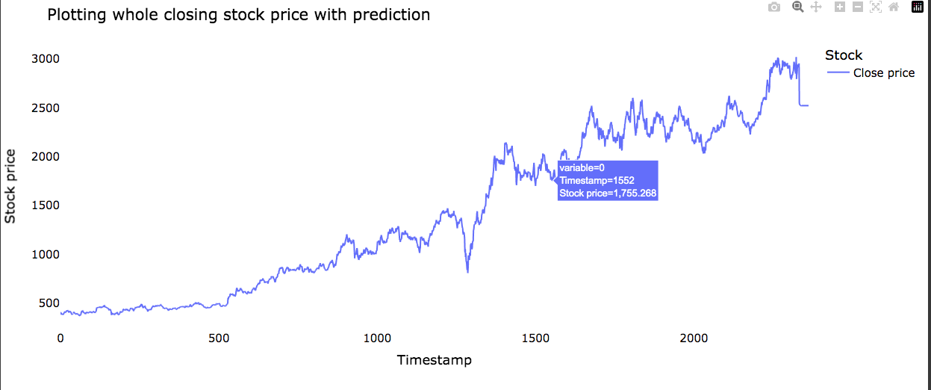

Slide 27
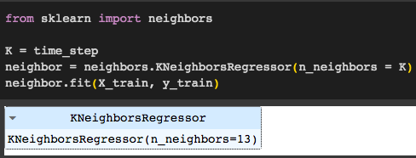
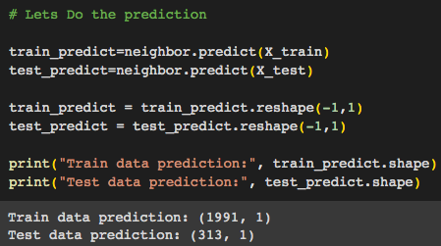
K-NEAREST NEIGHBOUR (KNN)

Slide 28
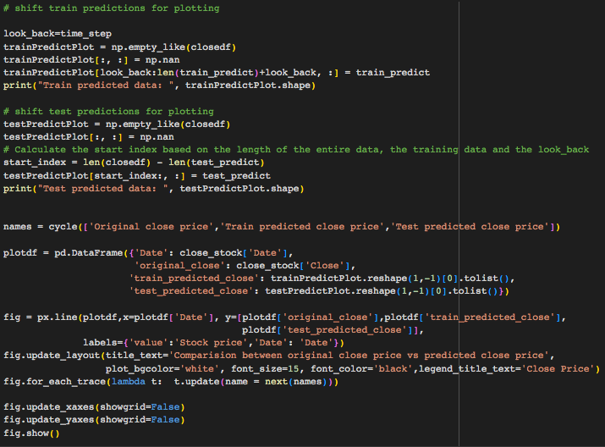
PREDICTION FOR PLOTTING

Slide 29
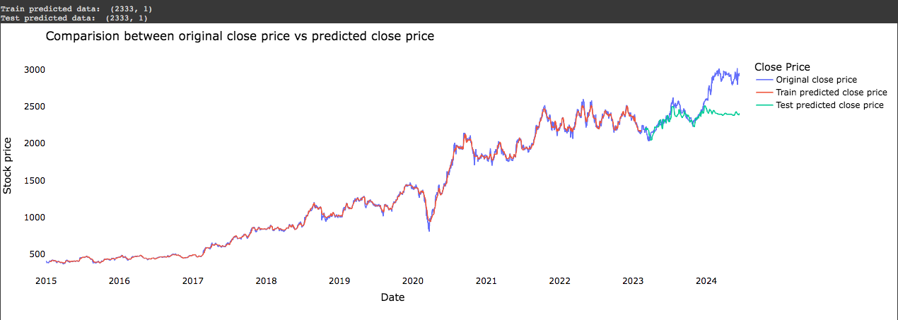
PREDICTION FOR PLOTTING

Slide 30
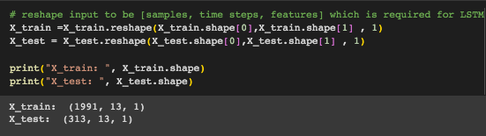
Long Short-Term Memory (LSTM)
LSTM networks, a type of Recurrent Neural Network (RNN), are effective for stock market prediction due to their ability to capture long-term dependencies in time series data. Using historical stock prices, an LSTM model can be built and trained to forecast future prices. In Python, the process involves data preprocessing, defining an LSTM architecture, training the model, and making predictions. This approach helps in creating accurate forecasts, aiding investment decisions.

Slide 31
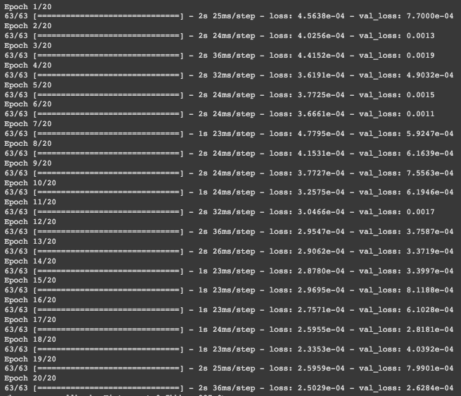
LSTM MODEL STRUCTURE

Slide 32
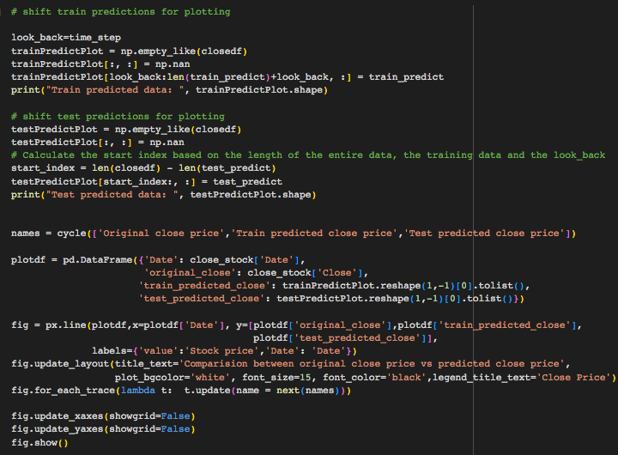
PREDICTION FOR PLOTTING

Slide 33
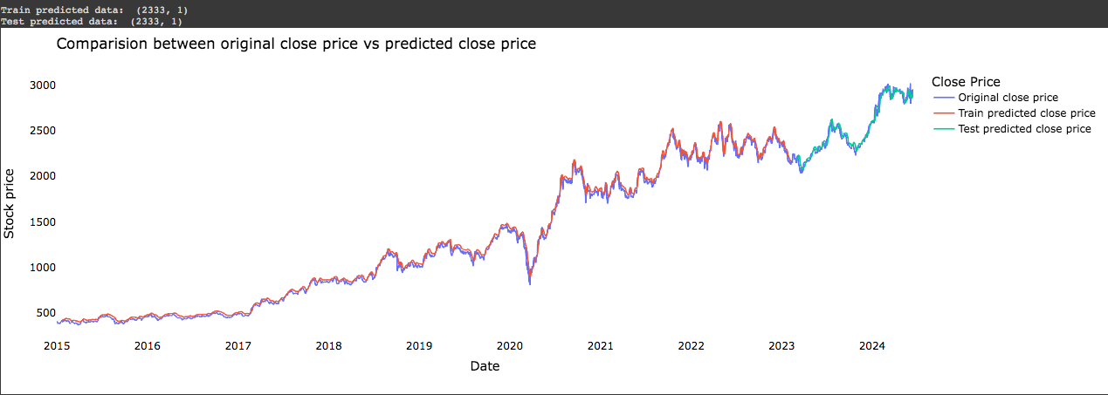
PREDICTION FOR PLOTTING

Slide 34
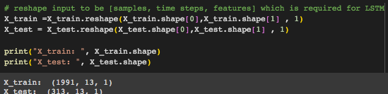
GATED RECURRENT UNIT (GRU)
In stock market analysis, the Gated Recurrent Unit (GRU) plays a pivotal role due to its efficiency in handling time-series data. Unlike traditional Recurrent Neural Networks (RNNs), GRU simplifies the architecture by integrating reset and update gates, allowing it to capture long-term dependencies effectively while mitigating the vanishing gradient problem. This makes GRU particularly suitable for predicting stock prices based on historical data sequences. By preprocessing and normalizing the data, building a GRU model using libraries like Keras, and training it on historical data, analysts can leverage GRU's capabilities to forecast future stock prices accurately, aiding in strategic investment decisions.

Slide 35
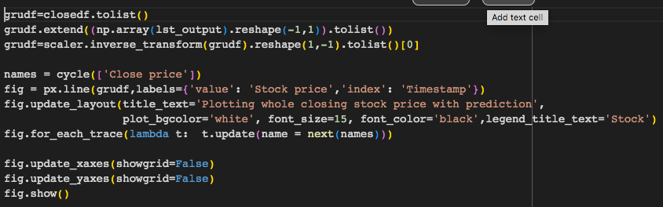
PLOTTING WHOLE STOCK WITH PREDICTION

Slide 36
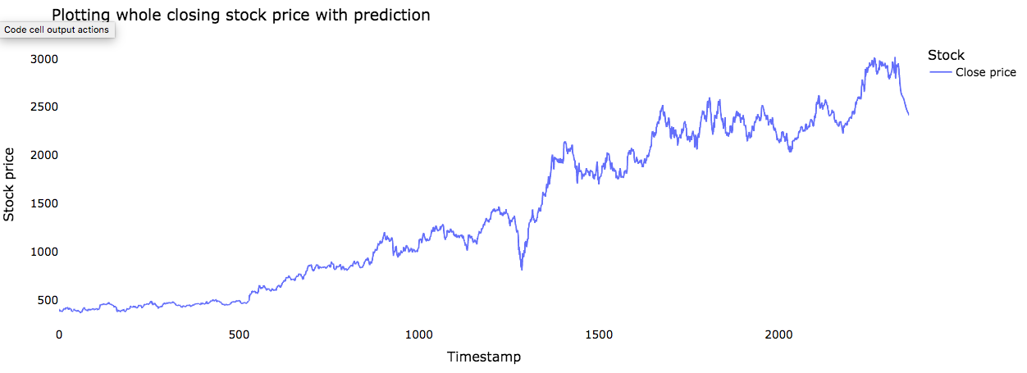
PLOTTING WHOLE STOCK WITH PREDICTION

Slide 37
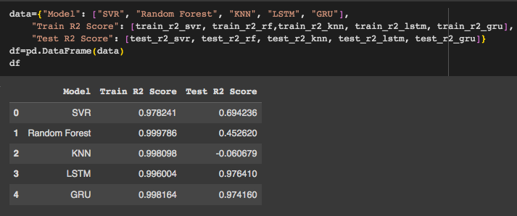
ALL TYPES OF MODELS

Slide 38
DEPLOYMENT
Deploying predictive models in stock market analysis involves converting trained models into deployable formats compatible with production environments, such as TensorFlow or PyTorch. Integration with data pipelines or APIs ensures real-time or batch data input, maintaining preprocessing steps for consistency. Scalability considerations include optimizing for performance and using cloud infrastructure or accelerators. Monitoring for accuracy and drift detection, along with regulatory compliance and risk management, ensures robust deployment that supports informed investment decisions in dynamic market conditions.

Slide 39
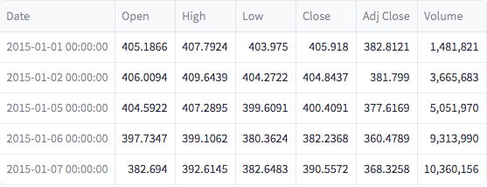
DATA SET PREVIEW

Slide 40
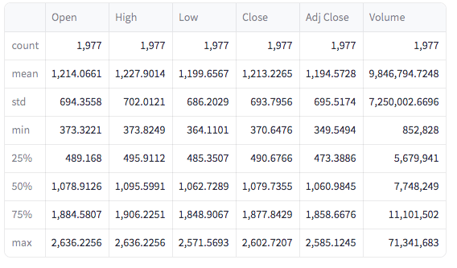
DATA DESCRIPTION

Slide 41
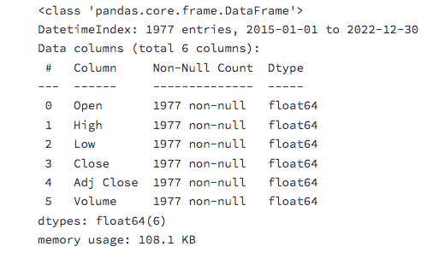
DATA INFORMATION

Slide 42
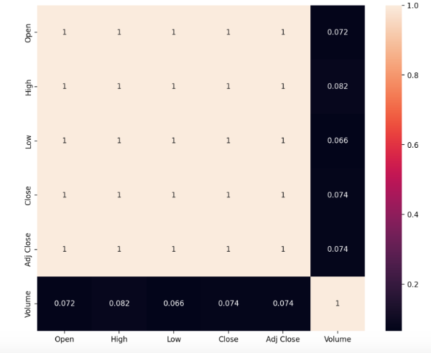
CORRELATION HEAT MAP

Slide 43
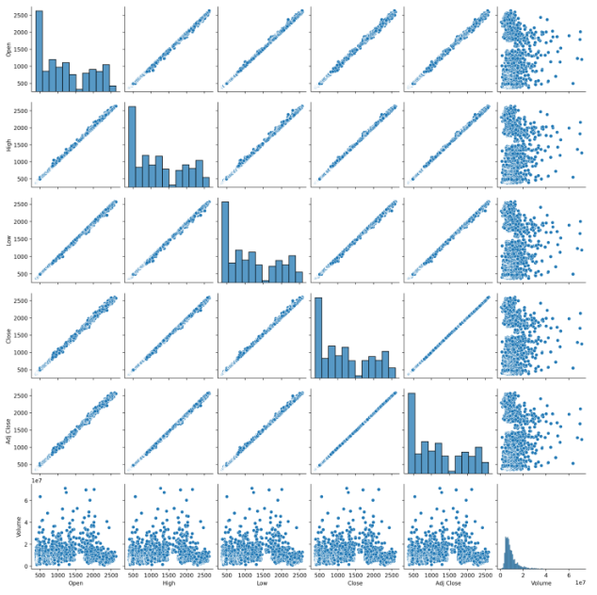
PAIRPLOT

Slide 44
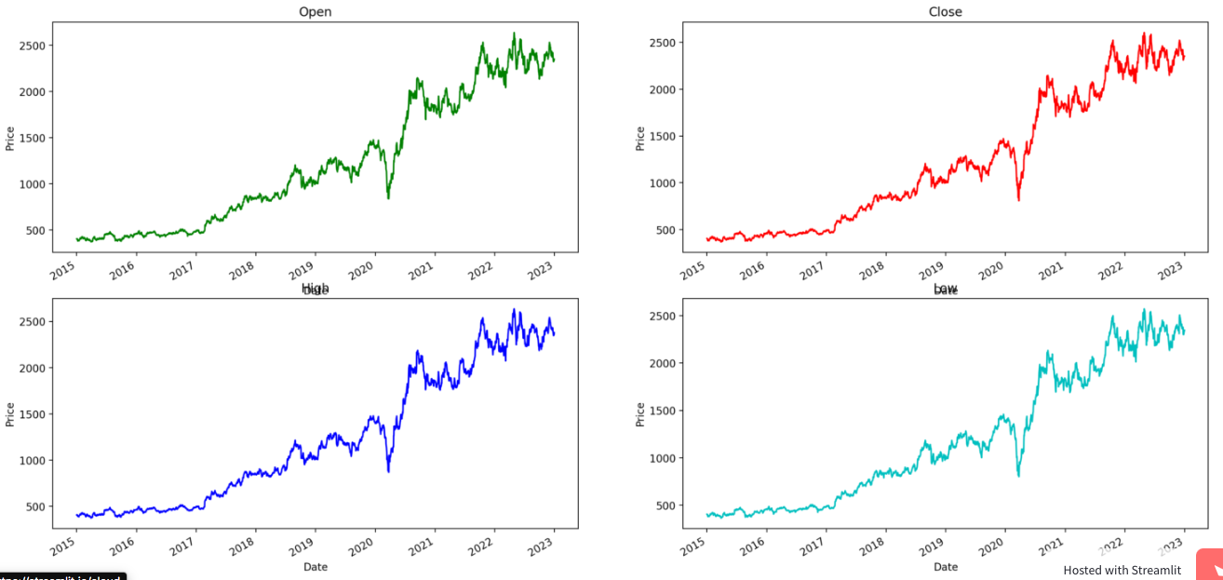
TIME SERIES PLOTS

Slide 45
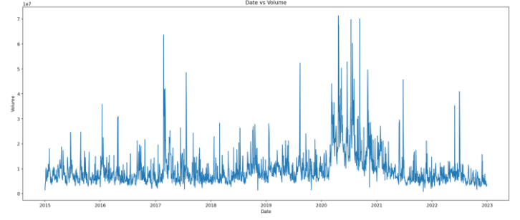
VOLUME PLOT

Slide 46
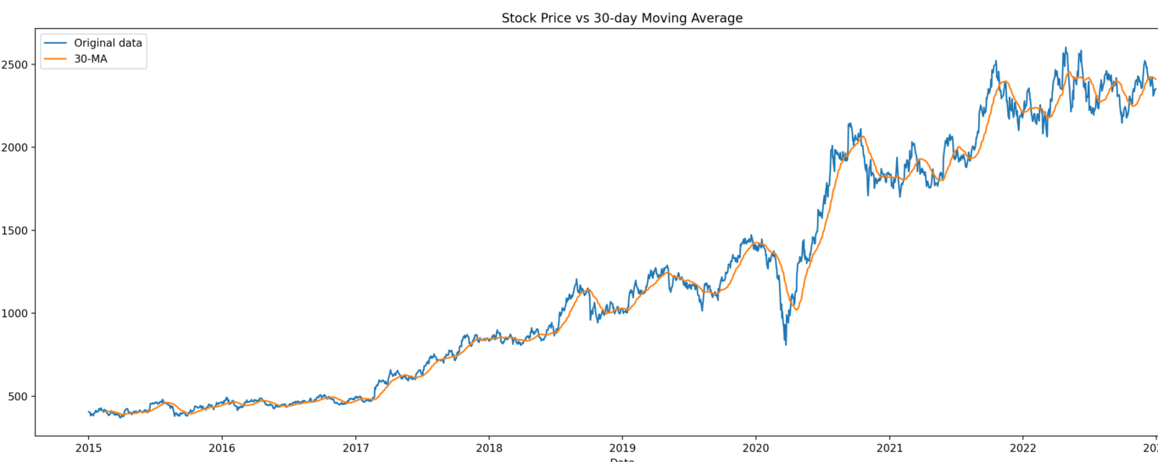
MOVING AVERAGES

Slide 47

MOVING AVERAGES

Slide 48

MODEL TRAINING - MODEL SUMMARY

Slide 49

TRAINED MODEL

Slide 50

PREDICTED PRICE

Slide 51

FUTURE PRICE PREDICTION

Slide 52
CONCLUSION
In conclusion, stock market analysis reveals crucial insights into market trends, investor behavior, and economic indicators. By leveraging technical and fundamental analysis, investors can make informed decisions to optimize returns and manage risks. Understanding market dynamics, diversifying portfolios, and continuously monitoring financial news and trends are essential for sustained success in stock investing. Effective analysis not only helps in identifying potential opportunities but also in mitigating potential losses, ensuring a more balanced and informed investment strategy. Moreover, staying updated with global economic developments and adapting to market changes enhances the ability to capitalize on emerging trends and navigate market volatility, ultimately leading to long-term financial growth and stability.

